Slide 1

Al-Zahraa University for Girls
College of health and medical technologies
Radiology department
The first stage
carboxylic acids and alcohols
Noor AL-Huda J.Hamza
2024-2025

Slide 2

What is carboxylic acid?
Individual activity

Slide 3
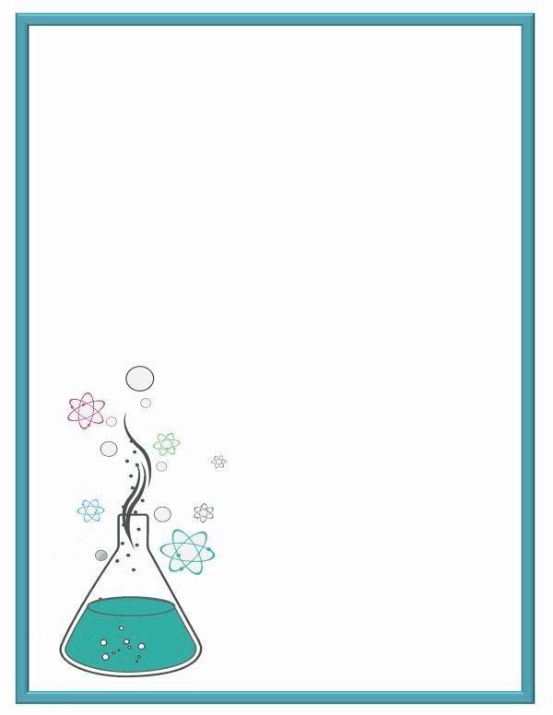
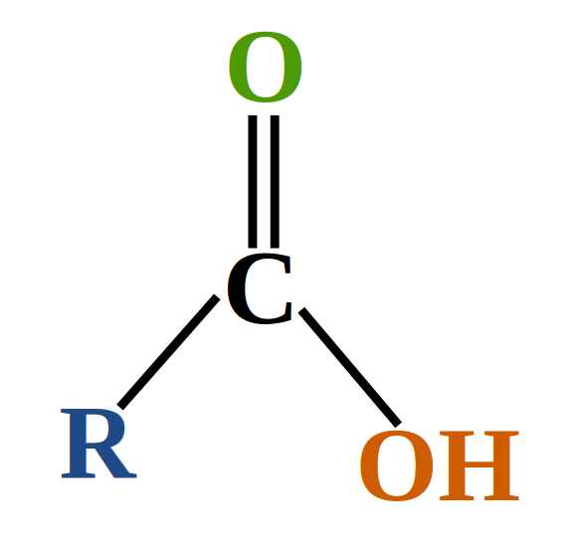
Carboxylic acids
Carboxylic acids are organic compounds containing a carboxyl group (-COOH).
- General formula: \(R-COOH\), where \(R\) represents an alkyl or aryl group.

Slide 4
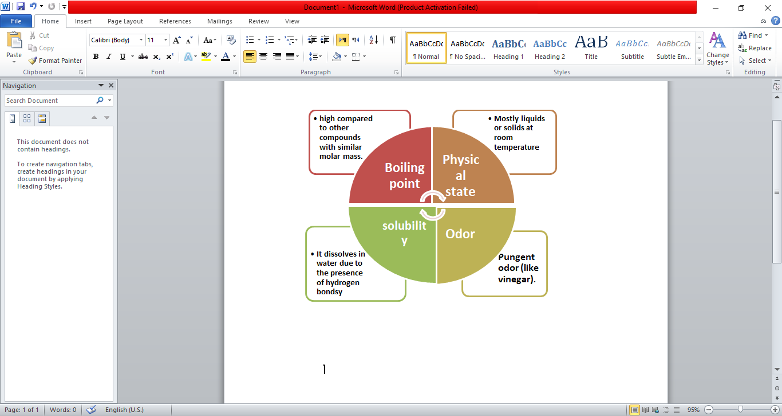
Physical Properties

Slide 5
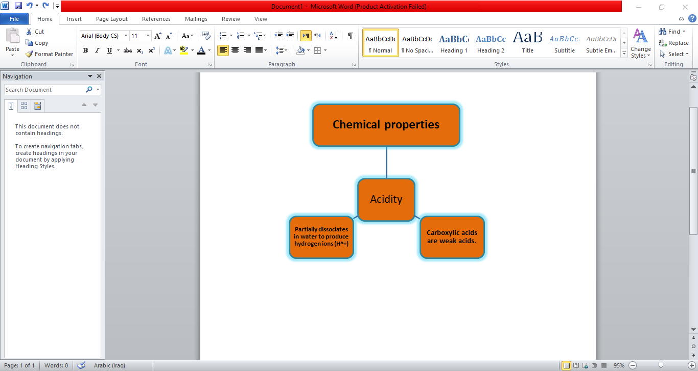

Slide 6
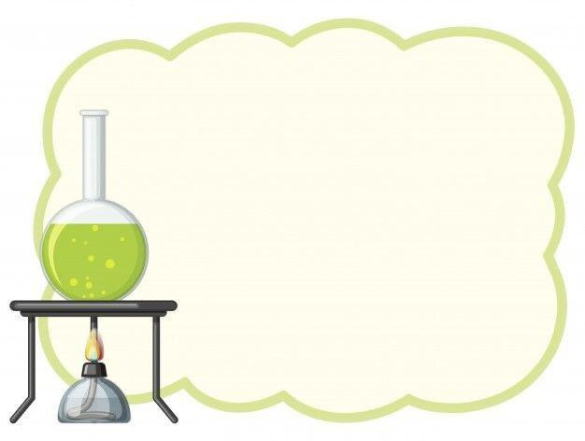
Group activity
Where is carboxylic acid used?.

Slide 7
Uses of carboxylic acids
1.In food industries:
- Acetic acid: making vinegar and preservatives.
2. In pharmaceutical industries:
- Salicylic acid: preparation of aspirin.
3.In chemical industries:
- Manufacture of dyes and plastics.
4. As a preservative:
- Benzoic acid in foods.

Slide 8

Alcohols
Alcohols are organic compounds containing a hydroxyl group (-OH).
General formula: R-OH where R represents an alkyl or aryl group.
Alcohols are polar compounds due to the presence of a hydroxyl group.

Slide 9
Type of alcohol
Primary alcohol: It has an OH group attached to one carbon atom.
Secondary alcohol: It has an OH group attached to two carbon atoms.
Tertiary alcohol: It has an OH group attached to three carbon atoms.

Slide 10

Individual activity
Identify the type of alcohol for each compound
CH3-CH2-OH
CH3-CHOH-CH3
(CH3)3C-OH
https://forms.gle/Pu3FKnno4dTpNPvJ9

Slide 11
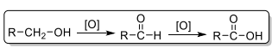
For oxidation in alcohols
Oxidation of primary alcohols
The primary alcohol is oxidized to an aldehyde using mild oxidizing agents.
The aldehyde can be oxidized to carboxylic acid when strong oxidizing agents are used.

Slide 12
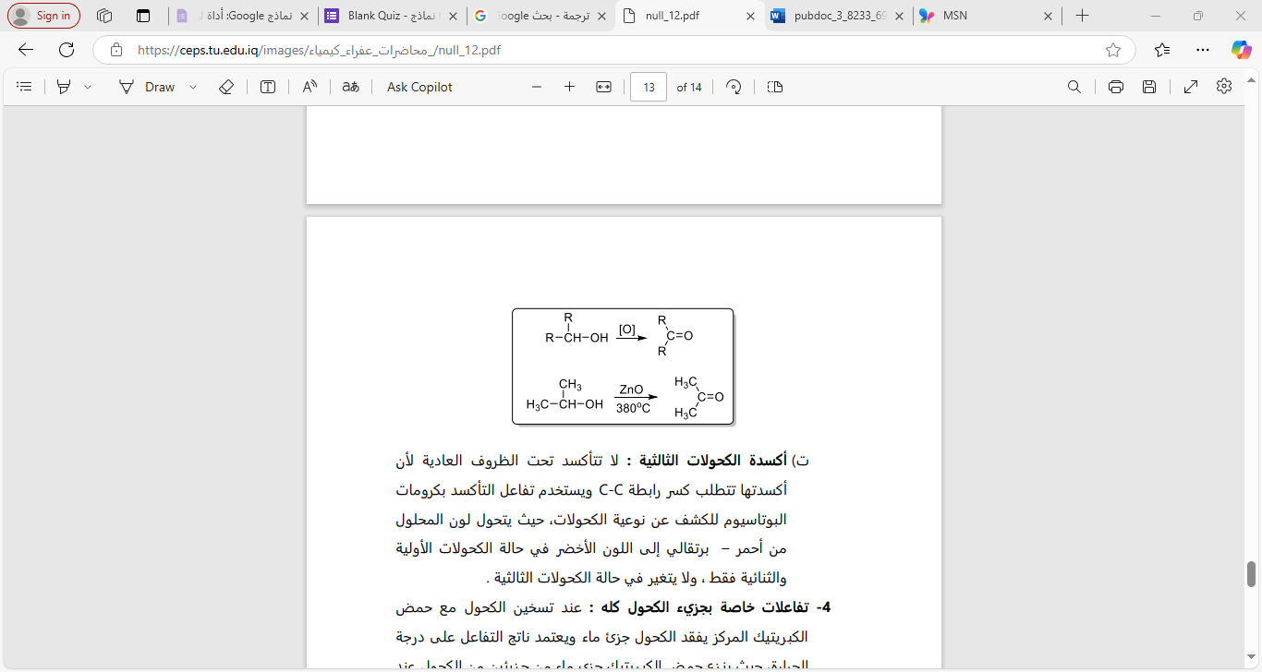
2. Oxidation of secondary alcohols
The secondary alcohol is oxidized into a ketone using oxidizing agents.
The ketone is not oxidized into another compound.

Slide 13

Write the equations for the oxidation reaction of the following alcohols :
Ethanol
2-Propanol

Slide 14
Methods of preparing alcohol
From alkenes: Addition of water to alkenes leads to acid catalysis.
CH2=CH2+H2O CH3-CH2-OH
From aldehydes: reduction of an aldehyde to a first alcohol.
CH3COCH3+H2+Ni CH3-CH-OH-CH3

Slide 15
Distinction between alcohols
Lucas reagent is used to distinguish between primary, secondary and tertiary alcohols, as tertiary alcohols respond directly, while secondary alcohols respond after five to eighteen minutes, but they do not respond in primary alcohol.

Slide 16
Uses of alcohol
1. Alcoholic beverages industry.
2. As a solvent in agricultural industries.
3. As a disinfectant in medicine.
4. In the beauty and cosmetics industry.

Slide 17

Glucose
is the most important monosaccharide of all. Its biological importance comes from
Its consumption by all cells of the body's tissues and the release of energy from it
Glucose is an aldohexose sugar found nutritionally in animal tissues and results from the
Complete decomposition of starch, maltose, and lactose.

Slide 18
Glucose levels are naturally regulated and controlled by the liver through the levels of the hormone insulin .
• The most important disease condition resulting from an imbalance in the blood glucose The level is diabetes mellitus, in which the glucose level exceeds 180 mg/dl, and this condition
is known as Hyperglycemia

Slide 19

What is the normal level of sugar
in the body?

Slide 20
Starch
It is an example of homogeneous polysaccharides, and it is the form that stores energy
in plants. It is also an important food source. Starch consists of two types of multiple
chains: amylose and amylopectin.

