Slide 1
Protozoa
Protozoa General Characteristics
1- Unicellular eukaryotes.
2- Have organelles that often function similarity to organs and systems of multicellular organisms
3- locomotion: pseudopodia, flagella or cilia
4- Reproduction: Asexual (binary fission or multiple fission) Sexual (conjugation or syngamy

Slide 2
Sarcodina
Sarcodina These organisms have streaming cytoplasm and use temporary cytoplasmic extensions called pseudopodia in locomotion (called amoeboid movement) and feeding.
Sarcodines include the genus Amoeba (see amoeba) and pathogenic species, e.g., dysentery-causing Entamoeba histolytica. These protozoans’ cells may be spherical or irregular in shape; the pellicle (or envelope) is usually thin and flexible.

Slide 3
Intestinal protozoa (Entamoeba histolytica)
Entamoeba histolytica is an anaerobic parasitic amoebozoan, part of the genus Entamoeba, Predominantly infecting humans and other primates causing amoebiasis, E. histolytica is estimated to infect about 35-50 million people worldwide
The word histolysis literally means disintegration and dissolution of organic tissues.
Morphological
Entamoeba histolytica has three stages
1. Trophozoite
2. Pre cyst
3. Cysts

Slide 4


Trophozoite of Entamoeba histolytica shows finger like psuedopodia and visible fine chromatin granule lining the nuclear membrane.2
Entamoeba histolytica trophozoite
E. histolytica cyst

Slide 5
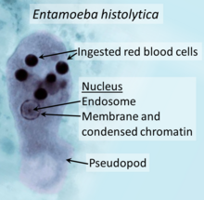
Scientific classification
Domain: | Eukaryota
Phylum: | Amoebozoa
Family: | Entamoebidae
Genus: | Entamoeba
Species: | E. histolytica
Binomial name
Entamoeba histolytica Schaudinn, 1903

Slide 6
Transmission
The active (trophozoite) stage exists only in the host and in fresh loose feces; cysts survive outside the host in water, in soils, and on foods, especially under moist conditions on the latter.
The infection can occur when a person puts anything into their mouth that has touched the feces of a person who is infected with E. histolytica, swallows something, such as water or food, that is contaminated with E. histolytica, or swallows . The cysts are readily killed by heat and by freezing temperatures; they survive for only a few months outside of the host. When cysts are swallowed, they cause infections by excysting (releasing the trophozoite stage) in the digestive tract.

Slide 7
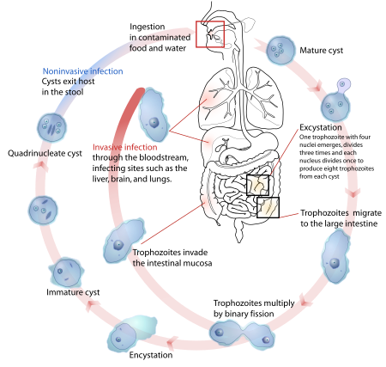
Life-cycle of Entamoeba histolytica

Slide 8
Amoebiasis
Amoebiasis: is intestinal parasitic infection caused by Entamoeba histolytica and commonly seen in tropical regions of the world, resulting from exposure to the contaminated food and water with fecal.
Amoebic dysentery
More severe inflammation with ulceration of the intestinal lining can occur in some people and this is called amoebic dysentery.
Signs and Symptoms:
1. Abdominal tenderness
2. Bloody stools
3. Fever
4. Vomiting

Slide 9
Laboratory diagnosis of Intestinal Amebiasis
1-Microscopy: Diagnosis may be made by the microscopic identification of cysts in solid feces (iodine mount) or Trophozoite in diarrheic stool (saline mount).
2-Serologic tests: such as, ELISA, for specific antibodies to E. histolytica are very helpful in diagnosis of invasive Amebiasis.
3-Molecular diagnosis: Polymerasechain reaction (PCR)
4-Real time PCR.

Slide 10
Treatment
1. Metronidazole
2. Tinidazole

Slide 11
Genus and species | Entamoeba histolytica
Etiologic agent of: | Amoebiasis; amoebic dysentery; extraintestinal amoebiasis, usually amoebic liver abscess; "anchovy sauce"); amoeba cutis; amoebic lung abscess ("liver-colored sputum")
Infective stage | Tetranucleated cyst (having 2–4 nuclei)
Definitive host | Human
Portal of entry | Mouth
Mode of transmission | Ingestion of mature cyst through contaminated food or water
Habitat | Colon and cecum

Slide 12
Pathogenic stage | Trophozoite
Locomotive apparatus | Pseudopodia ("false foot”")
Motility | Active, progressive and directional
Nucleus | 'Ring and dot' appearance: peripheral chromatin and central karyosome
Mode of reproduction | Binary fission
Pathogenesis | Lytic necrosis (it looks like “flask-shaped” holes in Gastrointestinal tract sections (GIT)
Type of encystment | Protective and Reproductive
Lab diagnosis | Most common is direct fecal smear (DFS) and staining (but does not allow identification to species level); enzyme immunoassay (EIA); indirect hemagglutination (IHA); Antigen detection – monoclonal antibody; PCR for species identification. Sometimes only the use of a fixative (formalin) is effective in detecting cysts. Culture: From faecal samples – Robinson's medium, Jones' medium

Slide 13
Thank you for listening

