Slide 1

College of Pharmacy Medical Microbiology Second Stage
Toxoplasma gondii Comprehensive Overview
Performed by:
Ass.lect Baneen Ali
Ass.lect Hadeel Qasem

Slide 2
Introduction
- Toxoplasma gondii is an obligate intracellular protozoan parasite.
- It is one of the most common parasites worldwide.
- While often asymptomatic, it poses risks for immunocompromised individuals and pregnant women.
- Infection is primarily transmitted through ingestion of contaminated food, water, or soil.

Slide 3
Life Cycle
1. Definitive Host (Cats):
- T. gondii undergoes sexual reproduction in the feline intestinal lining.
- Oocysts are shed in cat feces and can survive in the environment for months.
2. Intermediate Hosts:
- Humans, rodents, and birds ingest oocysts via contaminated food or water.
- The parasite forms tissue cysts in muscles, brain, and organs.

Slide 4
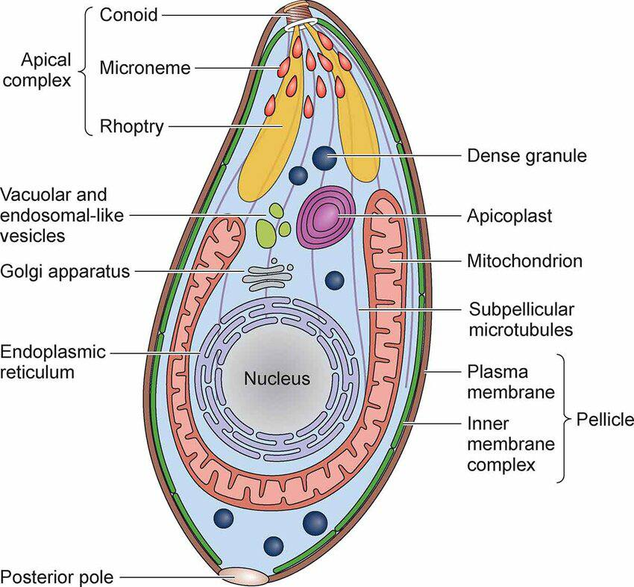

Slide 5
Modes of Transmission
- Consuming undercooked or raw meat containing tissue cysts.
- Ingesting water, soil, or vegetables contaminated with oocysts.
- Handling cat litter or soil without proper hygiene.
- Vertical transmission from mother to fetus during pregnancy.
- Rarely, transmission through organ transplantation or blood transfusion.

Slide 6
Clinical Manifestations
1. Asymptomatic:
- Most infections in healthy individuals are subclinical.
2. Mild Illness:
- Fever, muscle aches, swollen lymph nodes.
3. Severe Cases (Immunocompromised):
- Encephalitis, seizures, confusion, blurred vision, and respiratory issues.
4. Congenital Toxoplasmosis:
- Fetal abnormalities include hydrocephalus, intracranial calcifications, and retinochoroiditis.

Slide 7
Diagnosis
- Serology:
- IgG and IgM antibodies to determine recent or past infections.
- Molecular Testing:
- PCR to detect T. gondii DNA in amniotic fluid or blood.
- Imaging Studies:
- CT or MRI for detecting brain lesions or calcifications.
- Ophthalmologic Exam:
- Identification of retinochoroiditis in congenital or ocular toxoplasmosis.

Slide 8
Prevention
- Food Safety:
- Cook meat to internal temperatures of at least 63-74°C (145-165°F).
- Wash fruits and vegetables thoroughly before consumption.
- Hygiene:
- Wash hands after handling raw meat, soil, or cat litter.
- Pet Care:
- Clean litter boxes daily, wear gloves, and avoid allowing cats to hunt.
- Pregnancy Precautions:
- Pregnant women should avoid handling litter or consume properly cooked meals.

Slide 9
Treatment
1. Immunocompetent Individuals:
- Usually self-limiting, may not require treatment.
2. Severe Cases or Immunocompromised:
- Pyrimethamine + Sulfadiazine, supplemented with Folinic acid.
3. Pregnant Women:
- Spiramycin to prevent vertical transmission.
- Pyrimethamine and Sulfadiazine if fetal infection is confirmed.

Slide 10
Potential Complications
- Encephalitis and neurological damage in immunocompromised patients.
- Blindness due to retinal damage (ocular toxoplasmosis).
- Fetal developmental abnormalities in congenital toxoplasmosis.
- Chronic infection with possible reactivation under immunosuppression.

Slide 11
- Toxoplasma gondii is a significant global health concern.
- Preventive measures play a crucial role in reducing transmission.
- Early diagnosis and appropriate treatment improve outcomes, especially in high-risk groups.

Slide 12


