Slide 1

University of Al-Zahraa for women
College of pharmacy
Biochemistry
Third Stage
General Urine Examination

Slide 2
General Urine Examination
Routine screening test
Usually done as apart of physical examination, during preoperative testing and upon hospital admission.
It is used for the diagnosis of infections of the kidneys and urinary tract and also in the diagnosis of diseases unrelated to the urinary system.

Slide 3
General Urine Examination (GUE)
Consists of FIVE (or mostly three) parts:
Physical examination
Chemical examination
Microscopic examination
Culture and sensitivity
Cytopathology examination

Slide 4
Physical & Chemical urine exam
Appearance
Color
Odor
Specific gravity
ph
Leukocyte
Nitrate
Protein
Glucose
Ketones
Urobilinogen
Bilirubin

Slide 5
Appearance: refers to the clarity of the fluid. Deviations from the normal appearance of urine may indicate the presence of infection or hematuria.
Color: correspond to the specific gravity of the urine. There are many factors which can affect the color of urine, including food, drugs, and various conditions.

Slide 6
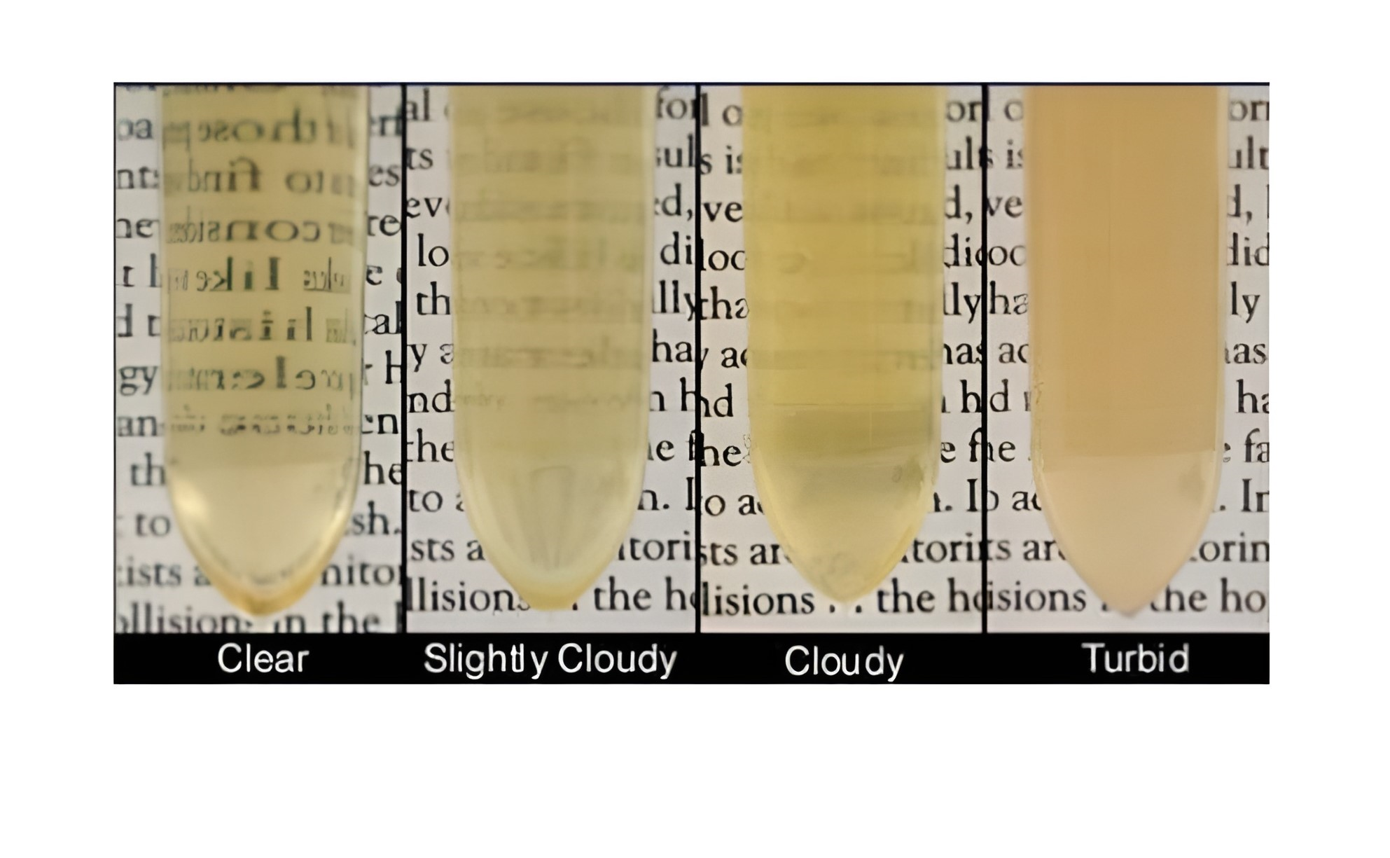
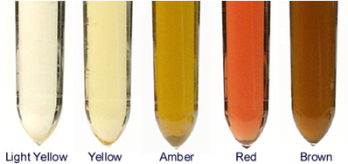
Normal: Light yellow to amber
Normal: Clear to slightly hazy

Slide 7
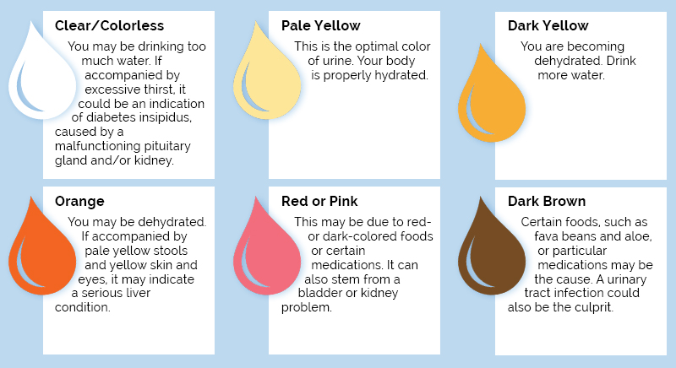

Slide 8
Odor: the normal odor of urine, aromatic, is due to its acidic content. Various conditions, medications, and foods may cause changes in odor of urine.
Specific gravity: is a measure of the concentration of the urine compared to the concentration of water, which is 1.000 g/cm3. the higher the SG, the more concentrated the urine.

Slide 9
Specific gravity: this test value is an indication of the kidney’s ability to concentrate and excrete urine.
The SG is normally lower in the elderly due to a decreased ability to concentrate urine.
There is condition known as fixed SG, in which the SG remains at 1.010, without variance from specimen to specimen. This is usually indicative of severe renal damage.
Normal SG range: 1.005-1.030 (or 1.015-1.025)

Slide 10
ph: provided information regarding the acid-base status of the patient (normally, 4.6-8.0).
Urine is considered alkaline when the ph is greater than 7.0, and is found in such conditions as urinary tract infection. When the urine ph is less than 7.0, or acidic in nature, the cause may be such problems as diarrhea or starvation.

Slide 11
Nitrate: is normally found in the urine (derived from dietary metabolites).
Protein: in the individual with normal renal function, there is no protein in the urine. This is due to the glomerular filtrate membrane of the kidney being impervious to the large protein molecules.
In the case of renal dysfunction, as in glomerulonephritis, the membrane is damaged, allowing the protein to pass

Slide 12
Glucose: As a part of the routine urinalysis, the urine is screened for the presence of glucose.
This screening is typically accomplished through use of reagent strip is dipped into the urine sample. The chemical reaction results in color changes which correspond to the level of glucose in the urine.
Normally, there should be no glucose in the urine, although occasionally a trace amount will occur during pregnancy. Should glucose be found in the urine (usually when serum glucose is > 180 mg/dl), a condition known as glycosuria, diabetes mellitus is suspected. However, further testing must be done to positively diagnosis this condition.

Slide 13
Urine strip test
Urine test strip is a basic diagnostic tool used to determine pathological changes in a patient’s urine in standard urinalysis.
Use a fresh, well-mixed, uncentrifuged urine.
The test method consists of immersing the test strip completely in a well mixed sample of urine for a short period of time, then extracting it from the container and supporting the edge of the strip over the mouth of the container to remove excess urine.

Slide 14
The strip is then left to stand for the time necessary for the reactions to occur (usually 1 to 2 minutes).
Finally the colors that appear are compared against the chromatic scale provided by the manufacturer.
The analysis includes testing for the presence of proteins, glucose, ketones, hemoglobin, bilirubin, urobilinogen, acetone, nitrite and leucocytes as well as testing of pH and specific gravity or to test for infection by different pathogens.

Slide 15
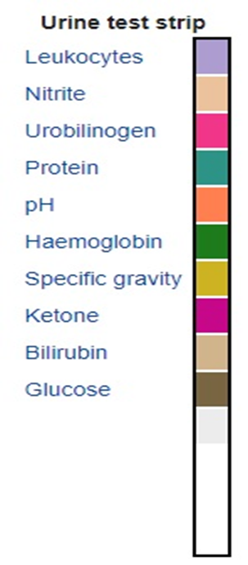

Slide 16
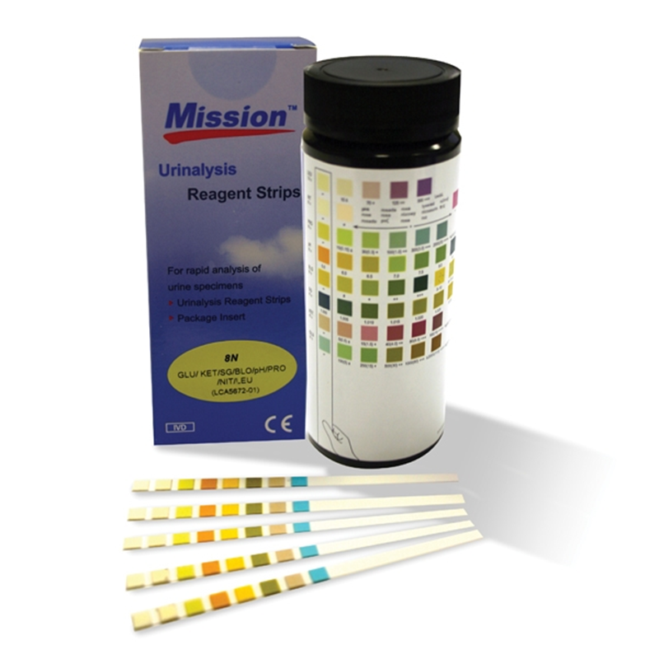

Slide 17
