Slide 1
Cardiovascular Pathology
Dr Esraa Ali Almustafa M.B.Ch.B /PATH

Slide 2
introduction
The normal heart weight varies with body height and weight. Averages approximately 250 to 300 g in females and 300 to 350 g in male
The heart, arteries, veins, and lymphatics make up the cardiovascular system.
These structures transport life-supporting oxygen and nutrients to cells, remove metabolic waste products, and carry hormones from one part of the body to another.

Slide 3
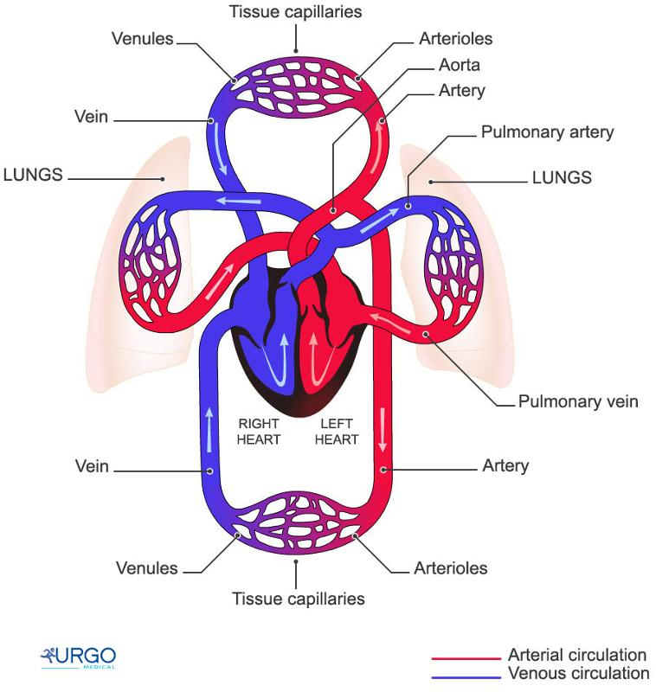
Circulatory system

Slide 4
The disorders discussed in this lecture include:
Atherosclerosis
Coronary artery disease (CAD)
hypertension (HTN)
heart failure

Slide 5
Atherosclerosis
Atherosclerosis is a chronic inflammatory disease of the arteries characterized by the buildup of fatty deposits, known as plaques, within the arterial walls
risk factors for atherosclerosis:
1- Non-modifiable risk factors:
Increase age
Male gender
Family history of cardiovascular disease

Slide 6
risk factors of atherosclerosis:
2- Modifiable risk factors:
hyperlipidemia
Hypertension
Cigarette smoking
Diabetes mellitus
Obesity
Physical inactivities
stress

Slide 7
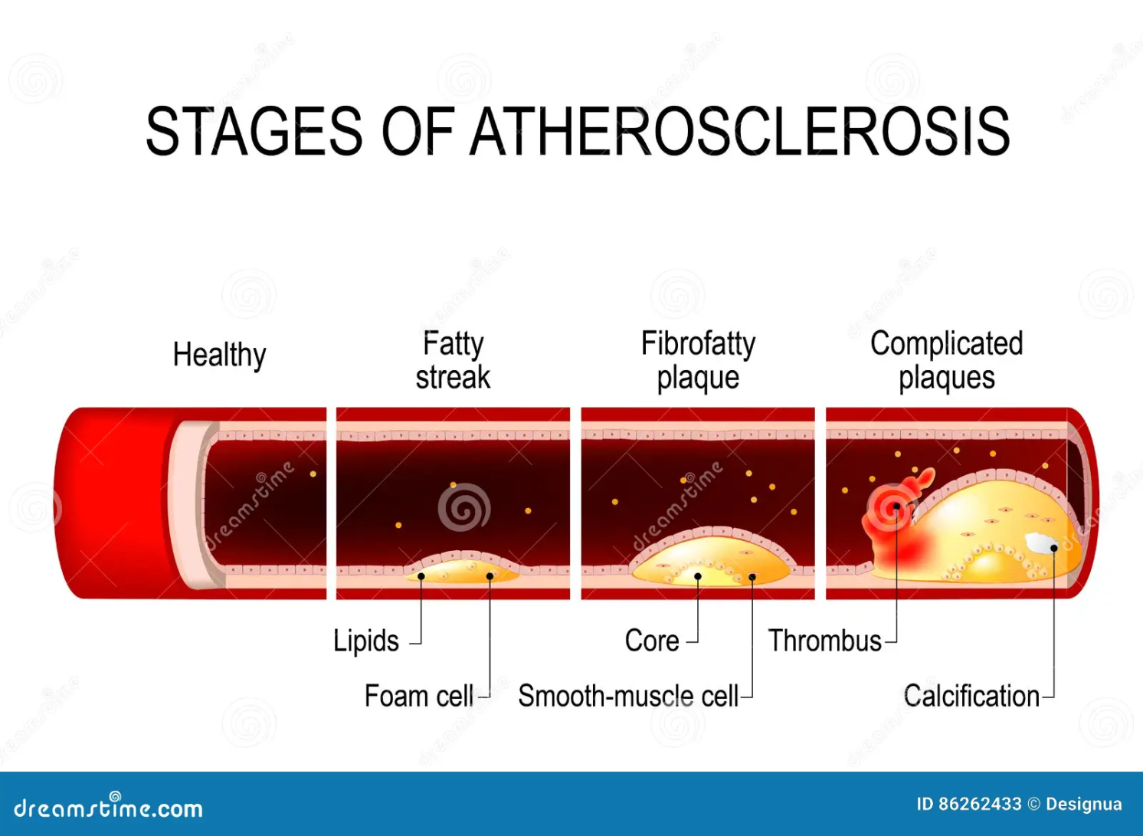

Slide 8
Pathophysiology
- Initiation: Atherosclerosis begins with endothelial injury caused by factors such as high blood pressure, high cholesterol, smoking, and diabetes.
- Progression: Following endothelial dysfunction, LDL cholesterol infiltrates the arterial wall and becomes oxidized. This triggers an inflammatory response, leading to the recruitment of monocytes, which differentiate into macrophages and engulf oxidized LDL, forming foam cells.
- Plaque Formation: As foam cells accumulate, they form fatty streaks, which can progress to larger plaques.

Slide 9
4- Plaque Progression and Growth
As the plaque grows, it becomes more complex, consisting of Lipid core & Fibrous cap
5- Plaque Rupture and Thrombosis
Atherosclerosis is a leading cause of morbidity and mortality worldwide due to its role in the development of cardiovascular diseases (CVD)

Slide 10
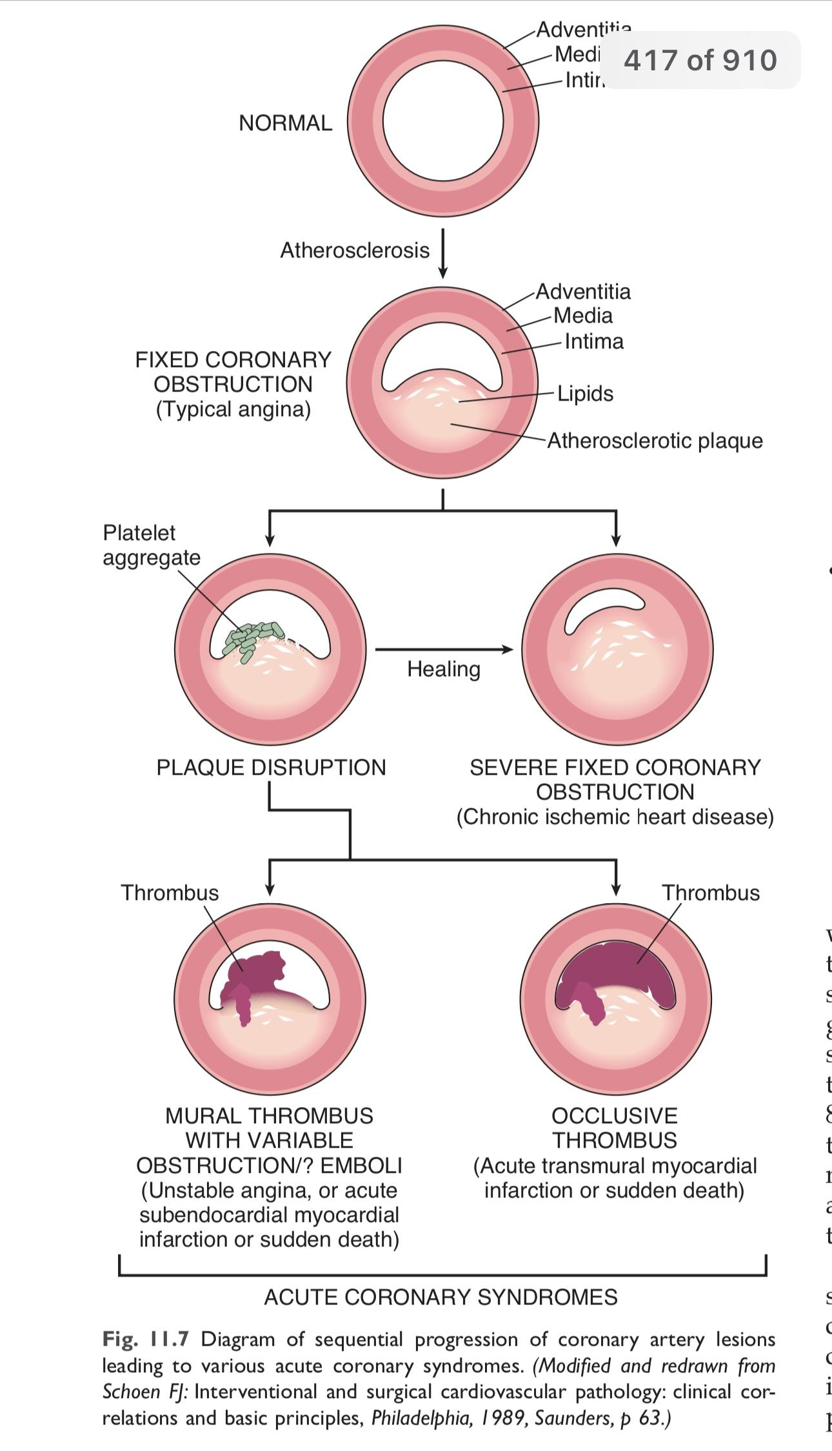

Slide 11
2- ISCHEMIC HEART DISEASE
Blood Supply of the heart
The three major coronary arteries are: •
(1) Left anterior descending (LAD).
(2) Left circumflex (LCX) arteries.
(3) Right coronary artery (RCA)

Slide 12
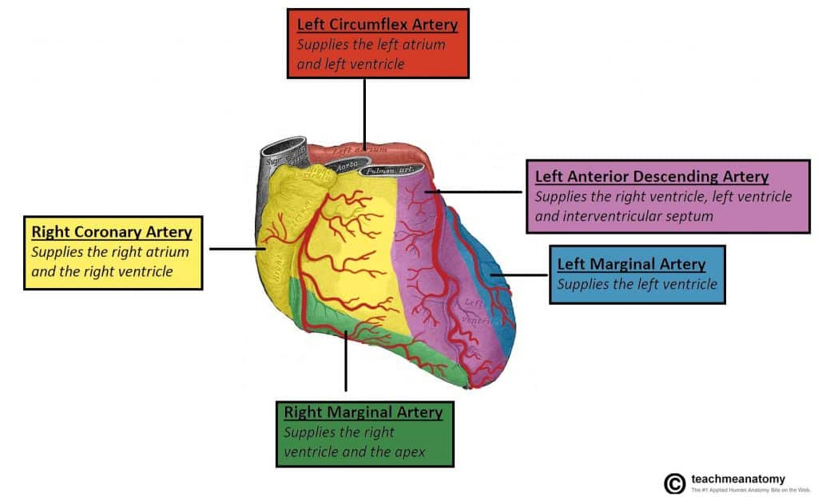

Slide 13
1 -Ischemic heart diseases or Coronary artery disease (CAD)
IHD represents a group of related entities resulting from myocardial ischemia - an imbalance between myocardial supply (perfusion) and cardiac demand for oxygenated blood. •
Ischemia not only reduces tissue oxygenation (and thus ATP generation), but also reduces the availability of nutrients and the removal of metabolic wastes

Slide 14
In more than 90% of cases, myocardial ischemia results from reduced blood flow due to obstructive atherosclerotic lesions in the coronary arteries; consequently, IHD is frequently referred to as coronary artery disease (CAD)

Slide 15
the clinical presentation may include one or more of the following cardiac syndromes:
Angina pectoris (literally, “chest pain”). Ischemia induces pain but is insufficient to cause myocyte death.
Myocardial infarction (MI). This occurs when the severity or duration of ischemia is sufficient to cause cardiomyocyte death
Chronic IHD with Congestive heart failure (CHF).
Sudden cardiac death (SCD).

Slide 16
Pathophysiology
As atherosclerosis progresses → luminal narrowing is accompanied by vascular changes that impair the diseased vessel’s ability to dilate.
▪ This causes an imbalance between myocardial oxygen supply and demand, threatening the myocardium beyond the lesion (↑ demand and ↓ supply).
▪ When oxygen demand exceeds what the diseased vessels can supply, localized myocardial ischemia result

Slide 17
1-Angina is the classical sign of CAD
Angina pectoris: recurrent retrosternal chest discomfort or pain caused by transient myocardial ischemia (15 seconds to 15 minutes). This ischemia is not sufficient to induce infarction.
The anginal pain is a consequence of the ischemia induced release of adenosine, bradykinin, and other molecules that stimulate sympathetic and vagal afferent nerves
Importantly, not all ischemic events are perceived (sensed) by patients; silent ischemia is particularly common in old aged population and in the setting of diabetic neuropathy

Slide 18
There are three overlapping pattern of angina
No.1 stable angina: chronic transient angina pectoris, precipitated by physical activity or emotional upset (increase cardiac muscle demand), relieved by rest within a few minutes. Usually occurs with lesions that occlude more than 70% of a vessel lumen
No.2 prinzmetal (variant) angina: Typical anginal discomfort, usually at rest, which develops because of coronary artery spasm
No.3 unstable angina: acute coronary syndrome characterized by progressively increase in frequency and more prolonged attack of angina. It is usually occur due to fixed stenosis that occludes 90% or more of a vascular lumen
. It has high frequency of progression to myocardial infarction if untreated

Slide 19
When to label it stable or unstable?
If the pain is predictable and relieved by rest or nitrates, it’s called stable angina.
If it increases in frequency and duration and is more easily induced, it’s called unstable angina
Fixed obstructions that occlude less than 70% of a coronary vessel lumen typically are asymptomatic, even with exertion

Slide 20
2- Myocardial Infarction
Myocardial infarction (MI), also commonly referred to as “heart attack,” is necrosis of the heart muscle resulting from ischemia
The major underlying cause of IHD is atherosclerosis
women are generally protected against MI during their reproductive years. However, postmenopausal decline in estrogen production is usually associated with accelerated IHD is the most common cause of death in older women.

Slide 21
Pathogenesis of Coronary Arterial Occlusion
. The following sequence of events likely underlies most MIs:
• An atheromatous plaque is eroded or suddenly disrupted by (endothelial injury, intraplaque hemorrhage, or mechanical forces) exposing subendothelial collagen and necrotic plaque contents to the blood.
• Platelets adhere, aggregate, and are activated, releasing thromboxane A2, adenosine diphosphate (ADP) - causing further platelet aggregation and vasospasm.
• Activation of coagulation by tissue factor and other mechanisms adds to the growing thrombus.
• Within minutes, the thrombus can evolve to completely occlude the coronary artery lumen.

Slide 22
The MI could be
Transmural MI: (full wall thikness) which is most common type about 90% of the cases. There is complete occlusion to the blood supply
Subendothelial MI: the subendothelium is the most vulnerable region to any reduction in blood flow.in this type there is advanced but not sever coronary atherosclerosis lead to subendothelial infarction only

Slide 23
Morphological features of MI:
macroscopical: pale infarcted area including the left ventricle and interventricular septum.
In subendothelial type the infarction is limited to the inner third of left ventricles. Infarcted heart less than 12 hour not suitable for gross examination.
microscopical: the myocardial cells show coagulative necrosis and this is not be detectable for the first 4 to 8 hours. The infarcted area infiltrated by acute inflammatory cells and if the patient survive the infarcted area replaced by granulation tissue and healed by fibrosis.

Slide 24
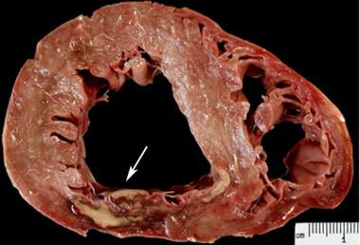
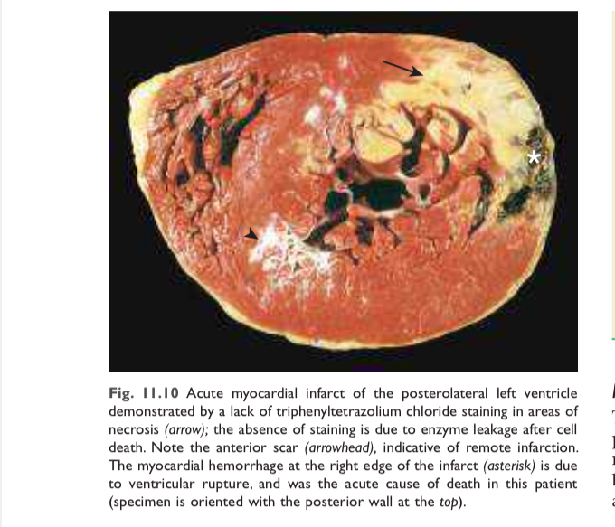

Slide 25
Complications of MI
• Heart failure
• Cardiac arrhythmia
• Contractile dysfunction
• Extension and expansion of the infarct •Ventricular aneurysm •
Mural thrombus
• Myocardial rupture
• Pericarditis

Slide 26
HYPERTENSIVE HEART DISEASE
Hypertension: defined as increase in blood pressure
Myocyte hypertrophy is an adaptive response to pressure overload; there are limits to myocardial adaptive capacity, however, and persistent hypertension eventually can result in
cardiac dysfunction,
cardiac dilation
CHF,
even sudden death

Slide 27
Blood pressure depends on cardiac output (CO) and systemic vascular resistance (SVR(
BP = CO x SVR * SVR= systemic vascular resistance
Cardiac output depends on heart rate (HR) and stroke volume (SV)
CO = HR x SV**
Systolic blood pressure = left ventricle contraction = stroke volume
Diastolic blood pressure = left ventricle relaxation = filling time = SVR

Slide 28
Mechanism of BP regulation:
Short term regulation:
Mediated by the sympathetic nervous system eg adrenaline it increase both HR and (SVR(
Baroreceptor reflex - senses pressure changes in aortic and carotid arteries. It responsible for regulation of short term blood pressure fall and correct it.
It Accommodate changes in posture, exercise, fear and anxiety, fever etc by increase HR and SVR

Slide 29
Long term regulation:
Major contributor is the renin-angiotensin-aldosterone system which stimulate the kidney to reabsorb water and electrolyte
Atrial natriuretic peptide (ANP): it is Natural diuretic, Causes kidneys to increase Na and water excretion
Antidiuretic hormone ADH: influence the kidney to reabsorb water
Endothelial and inflammatory cell mediators: initiating vasodilatory or vasospasm response

Slide 30
. Pathogenesis of hypertension:
First: increase cardiac output (increase cardiac preload): causes
increase fluid volume from excess sodium intake or renal sodium retention
Excess stimulation of the renin-angiotensin-aldosterone system (RAAS(
)
Second: increase systemic vascular resistance (after load hypertension)
Systemic vessels contraction (increase in sympathetic nervous system stimulation.
atherosclerosis

Slide 31
Types of hypertension
- Primary (Essential): No identifiable cause; influenced by genetic and environmental factors.
- Secondary: Caused by identifiable conditions (e.g., renal disease eg renal failure , endocrine disorders eg cushing syndrom , ).

Slide 32
MORPHOLOGY
Grossly
left ventricular hypertrophy, typically without ventricular dilation until very late in the process
Microscopically, the transverse diameter of myocytes is increased and there is prominent nuclear enlargement and hyperchromasia.

Slide 33
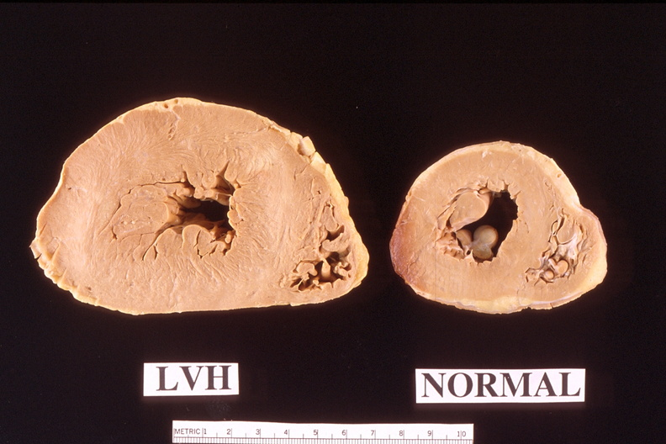
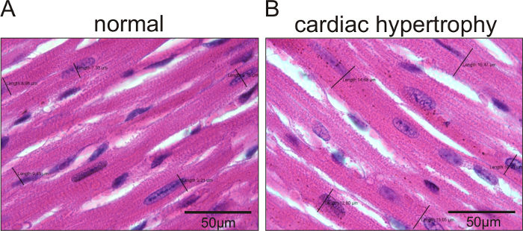
Gross and microscopic feature of cardiac hypertrophy

Slide 34
Heart failure
Heart failure is defined as the condition in which a heart cannot pump blood to adequately meet the metabolic demands of peripheral tissues
It is the common end stage of many forms of chronic heart diseases, often starting insidiously from the gradual effects of chronic work overload (e.g.
hypertension) or IHD (e.g., after myocardial infarction [MI] with heart damage
Heart failure may be classified in different ways according to its pathophysiology as Right-Sided or Left-Sided

Slide 35
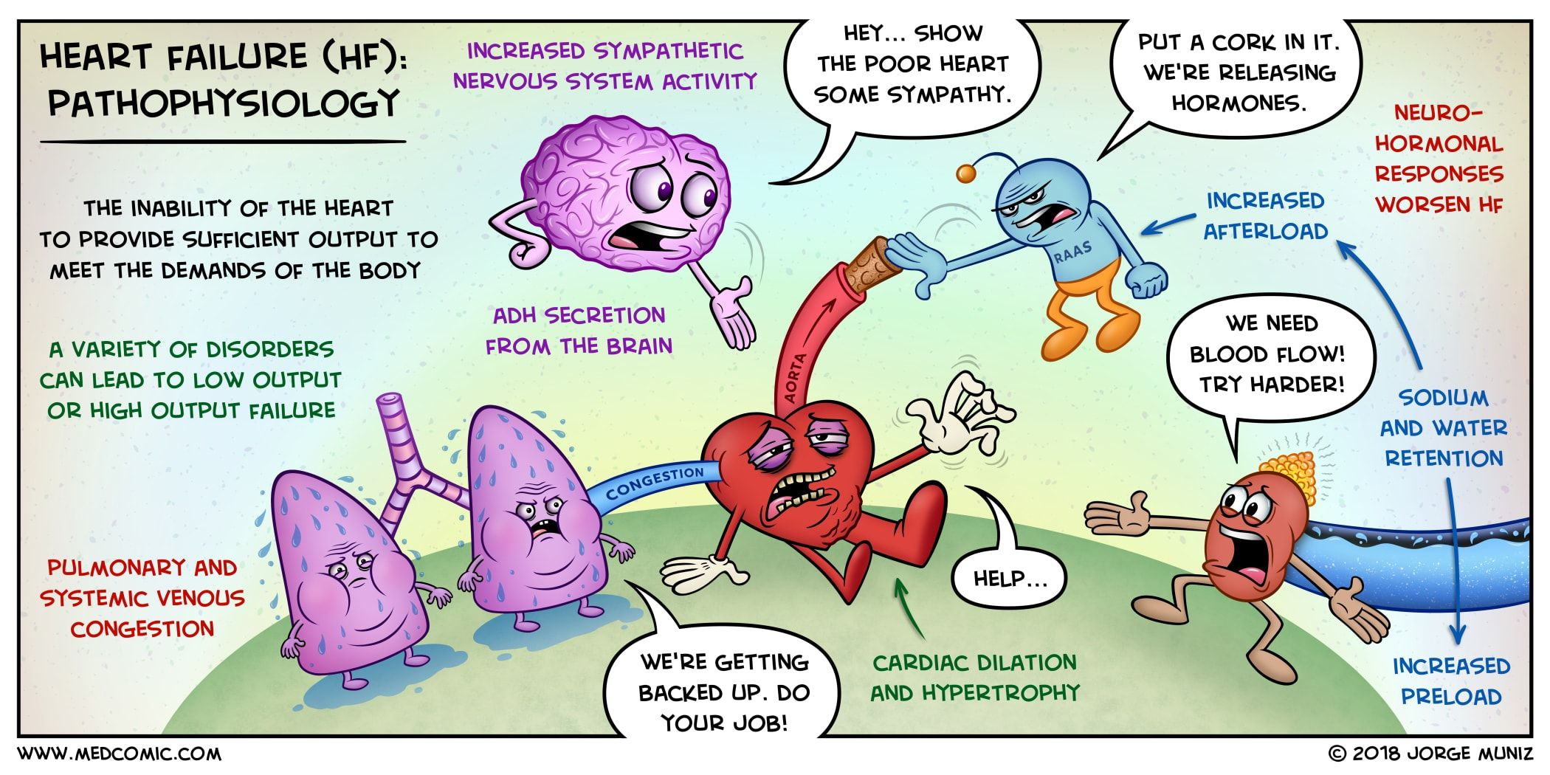

Slide 36
pathophysiological processes involved in heart failure
1. **Impaired Cardiac Function:- that impairs the heart's ability to pump effectively. This results in reduced cardiac output, leading to inadequate perfusion of tissues and organs
2- **In response to decreased cardiac output, the body activates neurohormonal systems
Eg Release of norepinephrine by adrenergic nerves of the autonomic nervous system increase heart rate

Slide 37
• Activation of the renin-angiotensin-aldosterone system, promoting water and salt retention
3 -Remodeling**: Chronic stress on the heart leads to structural and functional changes in the myocardium This includes myocardial hypertrophy, dilation of the heart chambers, and alterations in the extracellular matrix. Remodeling can further impair cardiac function and contribute to the progression of heart failure

Slide 38
If the dilated ventricle is able to maintain cardiac output that meets the needs of the body, the patient is said to be in compensated heart failure•
Increase cardiac dilatation results in increase tension of the affected chamber, causes increase oxygen demands of the myocardium.
With time the failing myocardium is no longer able to pump sufficient blood to meets the needs of the body even at rest

Slide 39
4 - Myocardial Dysfunction**: The impaired contractility of the heart muscle leads to decreased ejection fraction and reduced stroke volume leading to symptoms of heart failure such as fatigue, dyspnea, and exercise intolerance.

Slide 40
5-Fluid Retention**: The activation of the RAAS and the release of antidiuretic hormone (ADH) in response to reduced cardiac output lead to sodium and water retention by the kidneys. This results in volume overload, congestion, and edema, further exacerbating heart failure symptoms

Slide 41
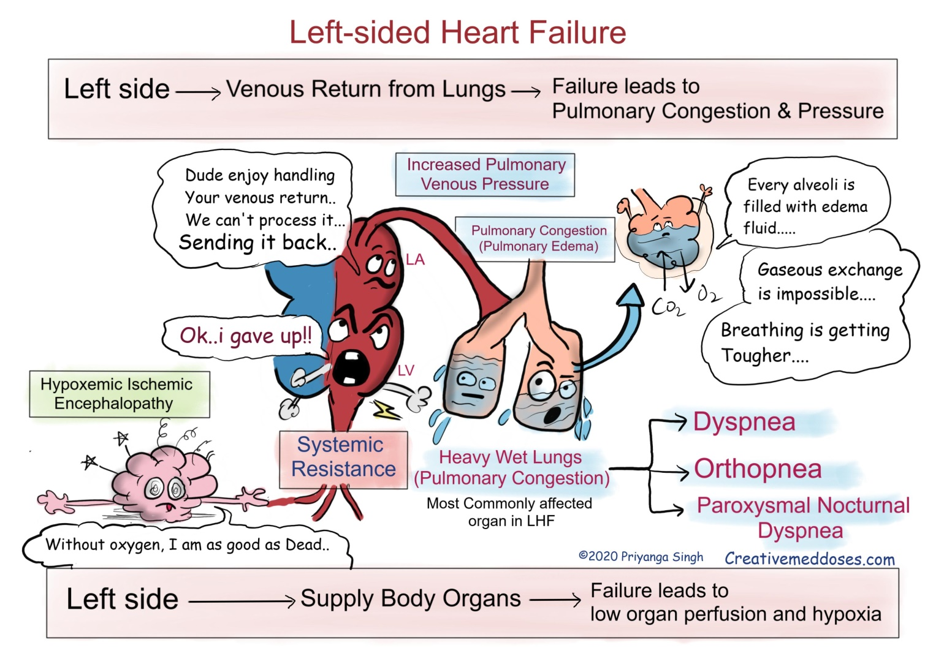

Slide 42
Left-Sided Heart Failure
It occurs due to ineffective left ventricular contractile function
often caused by the following:
IHD •
Hypertension •
Primary myocardial diseases
leading to:
✓Decreased cardiac output.
✓Fluid accumulation backing up into the left atrium and then into the lungs,
✓Pulmonary congestion or pulmonary edema.
which may result in right-sided heart failure.

Slide 43
Left-Sided Heart Failure (Pathophysiology)
1- Increased Workload: ➢
Increased workload enlarges the left ventricle.
➢The ventricle enlarges with stretched tissue rather than functional tissue due to lack of oxygen. ✓Symptoms: Increased heart rate, pale and cool skin, decreased cardiac output, and arrhythmias.
2- Decreased Ventricular Function:
➢Decreased left ventricular function allows blood to pool in the ventricle and atrium, eventually backing up into the pulmonary veins and capillaries.
✓Symptoms: Dyspnea on exertion, dizziness, orthostatic hypotension, decreased peripheral pulses and cyanosis.

Slide 44
3- Impaired Pulmonary Circulation:
➢Swollen pulmonary circulation increases capillary pressure, pushing sodium and water into the interstitial space, and causing pulmonary edema.
✓Symptoms: Coughing, crackles, tachypnea, increased pulmonary artery pressure, decreased pulmonary compliance.
4- Worsened Pulmonary Edema:
➢When the patient lies down, fluid in the extremities moves into the systemic circulation.
✓The left ventricle can’t handle the increased venous return, causing fluid to pool in the pulmonary circulation, worsening pulmonary edema.
5- Progression to Right-Sided Heart Failure: • The right ventricle becomes stressed due to greater pulmonary vascular resistance and left ventricular pressure, worsening symptoms.

Slide 45
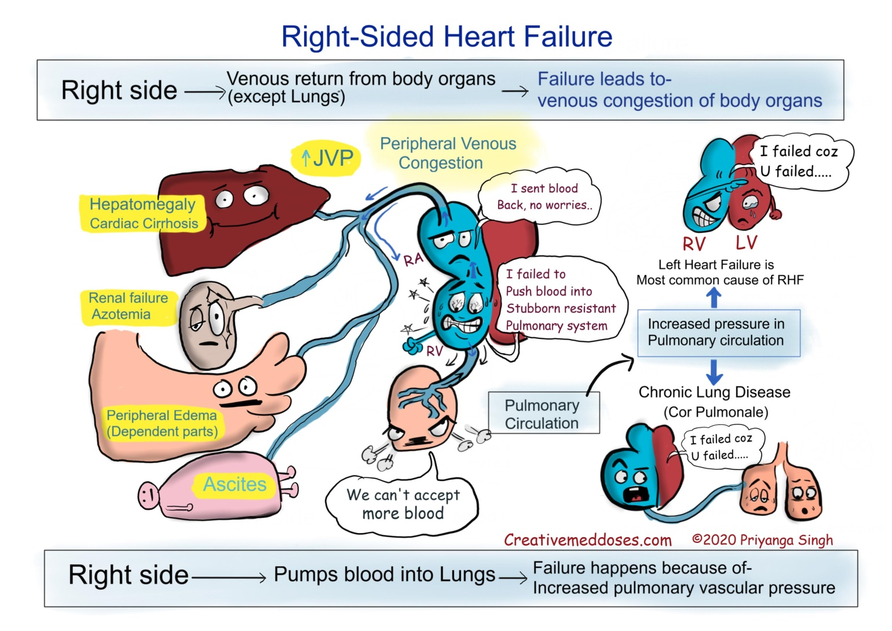

Slide 46
Right-Sided Heart Failure
It occurs due to ineffective right ventricular contractile function
the most common cause is profound backward flow due to left-sided heart failure.
➢other Causes include acute right ventricular infarction

Slide 47
Right-Sided Heart Failure (Pathophysiology)
1- Stretched Tissue Formation: ➢ leading to arrhythmias.
✓ Symptoms: Increased heart rate, cool skin, cyanosis, decreased cardiac output, palpitations, and dyspnea.
2- Decreased Right Ventricular Function:
➢ Blood pools in the right ventricle and right atrium. ➢ Backed-up blood causes pressure and congestion in the vena cava and systemic circulation.
➢ Systemic congestion results in
increased central venous pressure
➢ Distention of visceral veins (hepatic vein) causes liver and spleen swelling, impairing their function.

Slide 48
3- Increased Capillary Pressure:
➢ Increased capillary pressure forces excess fluid from capillaries into the interstitial space, causing tissue edema, especially in the lower extremities and abdomen. ✓ Symptoms: Weight gain, pitting edema

Slide 49
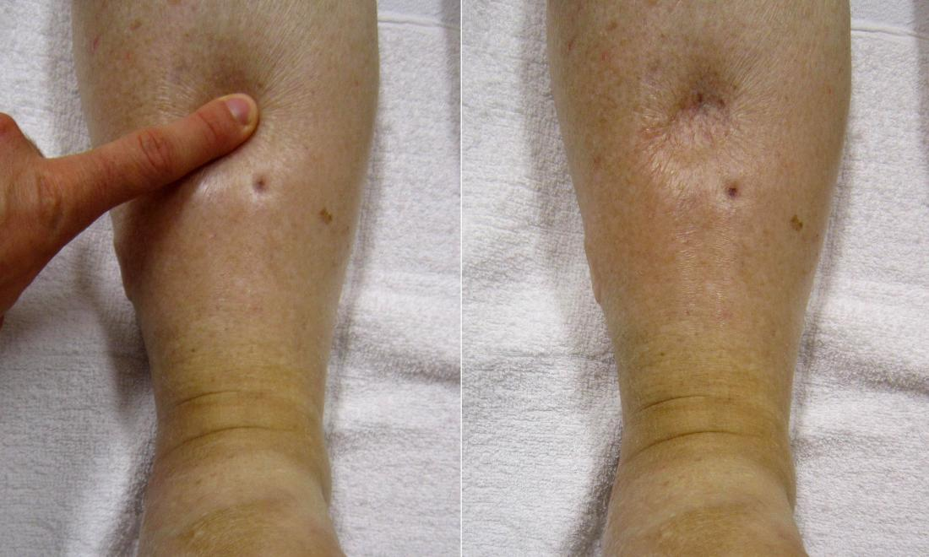

Slide 50
summery
Atherosclerosis is a chronic inflammatory disease of the arteries , Atherosclerosis is a leading cause of morbidity and mortality worldwide due to its role in the development of cardiovascular diseases (CVD)
IHD represents a group of related entities resulting from myocardial ischemia
Angina pectoris: recurrent retrosternal chest pain caused by transient myocardial ischemia (15 seconds to 15 minutes) without infarction
Myocardial infarction (MI), retrosternal chest pain caused by myocardial ischemia >20 minutes causing infarction
Hypertension: defined as increase in blood pressure
Heart failure is defined as the condition in which a heart cannot pump blood to adequately meet the metabolic demands of peripheral tissues

Slide 51
THANK YOU
ANY QUESTIONS ?

